Slide 1
Title IX Hearings and Adjudication –
Ensuring Fair Resolutions

Slide 2

The Worst Hearing Ever
Describe the most chaotic hearing or adjudication process you’ve observed.
What made it so bad?
What could we have done differently?

Slide 3
Pre-Hearing Conference
Clarify logistics, timing, and technology for the hearing
Review witness lists and anticipated evidence
Address accessibility accommodations or language needs
Ensure parties understand rules of decorum and cross-examination procedures
Emphasize Purpose

Slide 4
Best Practices
Hold at least 3–5 days before hearing
Include all parties, advisors, and hearing chair/decision-maker
Provide written summary of agreements and rulings afterward
Document objections raised and resolved
“A well-run pre-hearing conference is the scaffolding of a respectful and lawful adjudication process.”

Slide 5
Kicking Off the Hearing
Opening Remarks Should:
Reiterate the purpose of the hearing
Emphasize the institution’s commitment to fairness, neutrality, and respect
Identify all participants (Complainant, Respondent, Advisors, Witnesses)
Outline the order of proceedings
Set Ground Rules: Address expectations for decorum and conduct
Explain how cross-examination will proceed
Remind parties about recording, confidentiality, and procedural boundaries
Reaffirm that retaliation is prohibited
“How the hearing starts often shapes how the hearing goes. Authority, clarity, and empathy matter.”

Slide 6
Cross-Examination
“Questions and evidence about the complainant’s sexual predisposition or prior sexual behavior are not relevant,”— 34 C.F.R. § 106.45(b)(6)(i)
Exceptions: (1) To prove someone else was responsible (2) To show consent re: prior relationship with respondent

Slide 7
Relevance
“The Department acknowledges that determining relevance in real time during a live hearing may be difficult.”— 85 Fed. Reg. 30026, 30331 (May 19, 2020)
My personal rule: When in doubt about relevance, I generally allow the question. Why?
Relevance Is a Low Bar: Most relevance determinations should be quick and deferential. If a question might reasonably help assess credibility, bias, or facts at issue, it should be allowed.

Slide 8
Hypothetical Scenario
Two students, Taylor (Complainant) and Jordan (Respondent), attended a late-night gathering in the campus commons.
Both admit they drank alcohol.
Taylor alleges that Jordan engaged in sexual activity without consent later that night in Jordan’s dorm.
Jordan claims the encounter was consensual.
During the hearing, Taylor has testified about their memory of the evening, including what they drank, who they were with, and the moment they said “no.”
Jordan’s advisor begins cross-examination.

Slide 9
Relevant Or Irrelevant?
Question 1:“You said you had vodka, but isn’t it true you were also doing shots of Fireball before that?”
Question 2:“Didn’t you tell your roommate earlier that week you were into Jordan?”
Question 3:“Isn’t it true you kissed another person at the party before going upstairs with Jordan?”

Slide 10
Relevant Or Irrelevant?
Question 4:“You’ve accused someone of sexual misconduct before, haven’t you?”
Question 5:“You didn’t scream or fight back. Why not?”
Question 6:“You and Jordan were flirting in your group chat earlier that day. Can you explain that?”

Slide 11
Disruptive Advisors
Scenario: You’re conducting a hearing. The respondent’s advisor repeatedly objects mid-answer (“Objection! Hearsay!”) and tries to coach responses.
How do you respond in the moment? Do you stop the hearing? Do you warn them? What’s your tone?

Slide 12
Disruptive Advisors
Scenario: An advisor uses hostile tone and loaded questions during cross-examination (“Why are you lying about what happened?”).
What’s the standard for intervention? How do you balance fairness with decorum?

Slide 13
What Can You Do?
Remind them of ground rules at the outset
Interrupt and redirect when needed
Issue clear, progressive warnings
Document disruptive behavior
Remove an advisor only as a last resort

Slide 14
Report Writing Common Pitfalls
Failure to Adequately Explain Findings
Courts consistently criticize reports that contain conclusory statements with no rationale.
Common issue: Findings of responsibility or non-responsibility are stated without explaining why evidence was credited or discounted.
Example: “The panel found the complainant not credible,” but provided no reasoning, leaving the court unable to assess whether the decision was arbitrary.— Doe v. Univ. of Denver, 952 F.3d 1182 (10th Cir. 2020)

Slide 15
Report Writing Common Pitfalls
Ignoring or Mischaracterizing Evidence
Decision-makers sometimes omit key evidence or misstate what was said or submitted, raising concerns of bias or procedural irregularity.
Common issue: Not addressing documentary or witness evidence that contradicts the conclusion.
Example: In Doe v. Purdue Univ., 928 F.3d 652 (7th Cir. 2019), the university expelled a student without considering his version of events or exculpatory evidence.

Slide 16
Report Writing Common Pitfalls
Insufficient Analysis of Credibility
While credibility is often central, many reports fail to explain why a party or witness was or was not credible.
Common issue: Boilerplate language such as “The panel found the respondent more credible,” without connecting it to specific facts.
Courts expect: Acknowledgement of inconsistencies; evaluation of corroboration, motive, or plausibility; be careful about trauma-informed factors

Slide 17
A Moment On Sanctions
Purpose of Sanctions
Restore or preserve equal access to the education program
Address the harm caused and prevent recurrence
Sanctions are not punishment for punishment’s sake—they serve institutional equity
Considerations When Determining Sanctions
Nature and severity of the misconduct
Impact on the complainant and broader campus community
Whether the respondent poses an ongoing risk
Prior misconduct history (if any)

Slide 18
“Design the Ideal Hearing”
Share creative or unusual ideas that worked for your institution

Slide 19
Challenges
Retaliation
Disabilities and Intersectionality
Bias and Conflict of Interest
Coordinating with Law Enforcement

Slide 20
Informal Resolution

Slide 21


Slide 22
First Principles: Overarching Title IX Duty
Prevent/Remedy Sex Discrimination!
Supportive measures
Equitable treatment
Respond to known acts of sexual harassment in a manner that is not “clearly unreasonable”
Generic Hypo: Your president has asked you to explain to him why the university’s response to a report of sex harassment was not clearly unreasonable.
What facts would you want to be able to cite?

Slide 23

The Regulations In A Nutshell
An optional institutional alternative (should, when, how, & by whom)
Guidance paperwork (how does process work & consequences of participating in the process)
Voluntary for both sides (how to assess & demonstrate)

Slide 24
In The Courts
Very few reported cases analyzing informal resolution practices
Why?
Federal courts have been reluctant to allow deliberate indifference claims based on an institution’s use of an informal resolution process in general
Key issues: voluntariness, timeliness, and remedies/enforcement
Communicate with parties about status (where are we)
If the institution follows policies and procedures, courts appear to be reluctant to second-guess the decision or outcome.

Slide 25
Hypothetical: The Case of the Class Project Pairing
Jordan (they/them), a junior, alleges that Alex (he/him), a senior, made unwelcome sexual advances during a group meeting, including comments and touching. Jordan does not want a hearing but is open to informal resolution with conditions. Alex denies the allegations but is open to “resolving it quietly.” You’re the Title IX Coordinator. Should informal resolution be offered?

Slide 26
Would You Offer Informal Resolution?
Work in small groups or at your table. You’ll have 10 minutes to review the case and decide:
Is this matter eligible for informal resolution under your policy?
Would you offer it?
What would you want to see in the terms?
What concerns might lead you to say no?

Slide 27
Group Discussion Prompts
Is the allegation (unwanted touching, suggestive comments) eligible under your policy?
Are both parties truly engaging voluntarily?
Would informal resolution preserve educational access and safety?
What safeguards or terms would make you more comfortable proceeding?
What are the risks—either of proceeding or declining?

Slide 28
Threshold Question: Should Informal Resolution Even Be An Option?
The Easy “No”: allegations that an employee sexually harassed a student
The Complicated: Are there situations where informal resolution would be not appropriate (or “clearly unreasonable”)?
One potential guidepost: if allegations are true, would it be appropriate for accused to remain on campus (on-going threat to campus community → gravity of the alleged offense, repeat offender, risk of repeating, weapons, minor victim, etc.)

Slide 29
Three Suggested Best Practices
Clear policy language is important -- Make sure the policy reflects (a) who needs to consent to an informal resolution and (b) what factors university officials will consider
Show your work -- document your analysis (sorry)
Monitor for consistent application and implicit bias (i.e., similar fact patterns should be handled consistently)

Slide 30
You Say Yes! Now to Complainant
Discuss options with Complainant
Explain the IR process in writing
Form document that satisfies regulatory requirements → Have a non-lawyer human being read this for clarity
If Complainant says “no,” that’s a wrap
What do you say about IR?
What are pros & cons to mention?
What should you avoid?
Timing?
What are some of the questions you may get from the Complainant?

Slide 31
Complainant Say Yes! Now to Respondent
Discuss options with Respondent
Explain the IR process in writing
Form document that satisfies regulatory requirements → Have a non-lawyer human being read this for clarity
If Respondent says “no,” that’s a wrap
What do you say about IR?
What are pros & cons to mention?
What should you avoid?
Timing?
What are some of the questions you may get from the Respondent?
*** can this be used against me in a subsequent proceeding? Sent to subsequent schools? Part of education record?

Slide 32
How Do We Ensure Voluntary Participation?
Clear communications (can’t stress this enough)
Be timely, but don’t rush
Require parties to sign a clear Participation Agreement
Periodic check-ins and monitoring (Who? How?)
Reiterate where appropriate that either party can stop the process
What would be a red flag about a party’s voluntary participation?
Rule → when in reasonable doubt, put concern on table/stop the process
Show your work (again – sorry)
What if…once you’re done, a party objects that they didn’t, in fact, voluntarily participate?

Slide 33
Types of Informal Resolution
Administrative adjudication
Facilitated conversations
Restorative justice
Mediation

Slide 34


Slide 35
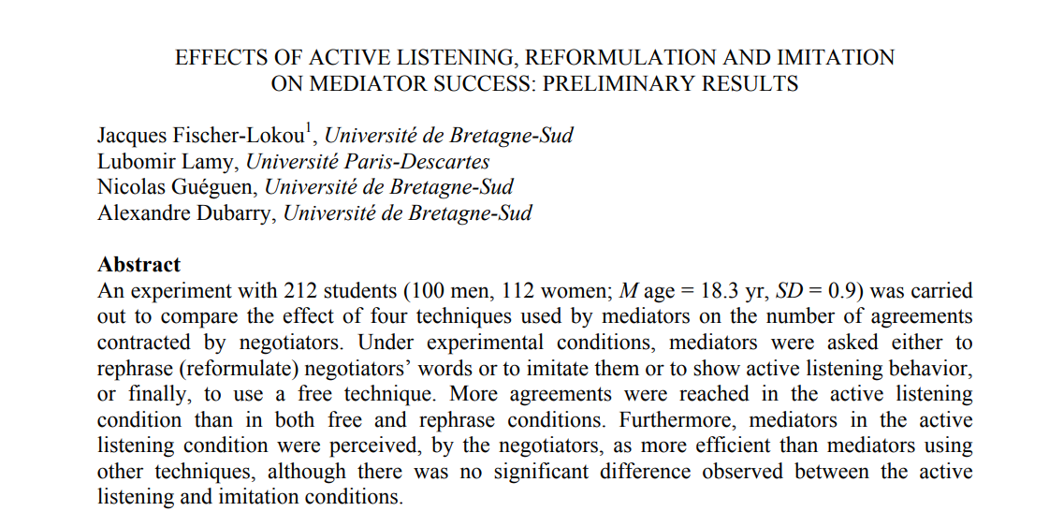
What Makes A Good Mediator?
Reasonable participants
Ability to establish rapport
Listening for Understanding/Establishing trust (what can I share?)
Soliciting what parties want & setting expectations
Creativity

Slide 36
Four Items For Preparation Of Mediator
Reasonable summary of report and status
Background information on parties and advisors
Information for assessment of potential conflicts
Summary of concerns raised (if any) in screening process

Slide 37
My Personal Preference for Process Steps
Send an introductory communication where I discuss process and begin scheduling meetings
Meet with complainant (listen primarily & get a sense of remedies sought)
Meet with respondent (listen primarily & get a sense of willingness to address harm)
Assess and plot next steps

Slide 38
Some General Question Possibilities
“I’ve read the materials in this matter and am familiar with the report, is there anything else you think is important to share with me?”
“Can you walk me through what you would like to achieve through this process?”
“Are there things you are willing to do remedy the harm Complainant has expressed?”

Slide 39
How Long Should Process Take?
From regulations: “reasonably prompt” with extensions for “good cause” with written notice to parties
Practical 1: comply with institutional policy
Practical 2: I worry when I’m past 21 days from receiving file
Is there a reasonable basis for resolution?
Is it worth setting a firm deadline for a response?
Ensure parties and IX Coordinator are apprised of where things stand

Slide 40
Some Outcome Examples
Administrative accommodations such as adjusting class schedules, changing sections, etc.
Apologies
Voluntary educational, mentoring, or coaching sessions
Relocation or removal from a residence hall or other on-campus housing
Verbal cautions/warnings
Training
Collaborative agreements on behavioral or institutional changes
No on-going contact
Voluntary withdrawal from university ***

Slide 41
Example Confidentiality Language in Agreements
“I agree that to the extent permitted by law, I will not use information obtained and utilized during informal resolution in any other institutional process (including investigative resolution under the Policy if informal resolution does not result in an agreement) or legal proceeding, though information documented and/or shared during informal resolution could be subpoenaed by law enforcement if a criminal investigation or civil suit is initiated.”

Slide 42
Post-Conference: Monitoring
This is mission critical!
Clarity on who is responsible
Hypo: Respondent becomes non-responsive and does not participate in agreed-to educational activities.
How do we enforce?

Slide 43
Guideposts (One More Time)
Respond to known acts of sexual harassment in a manner that is not “clearly unreasonable”
Complainant: Continue in educational program
Respondent: Continue in educational program so long as there is no harm to campus community
The perspective is peacemaking, supportive, and educational – it’s not confrontational, punishment-oriented, or overly legalistic
Keep the parties posted
Be honest with the parties but stress they control outcome (this is voluntary!)
Be timely

Slide 44
Title IX & Title VI under the Trump Administration

Slide 45


Slide 46


Slide 47
Ideological Shift: From “Equity” to “Merit-Based Neutrality”
Civil rights enforcement as a tool to combat “reverse discrimination”, racial preferences, and “radical DEI ideology.”
Emphasizes colorblind constitutionalism and biological definitions of sex under Title IX.
Asserts that many previous recommended civil rights practices (e.g. DEI programs, trans inclusion policies) are themselves discriminatory.

Slide 48
Executive Orders Dismantling DEI
EO 14151: Abolished DEI infrastructure in federal agencies.
EO 14173: Ended affirmative action-style mandates for federal contractors and required certification of race-neutral practices to receive federal grants.
Federal contractors and grantees (including universities) must certify that they do not operate “unlawful DEI programs.”

Slide 49
Unprecedented Aggressive Use of Title VI and Title IX
Title VI: Used to investigate and sanction institutions for alleged race- or ancestry-based preferences, especially in DEI, scholarships, and antisemitism cases.
Title IX: Redefined by executive order to cover only biological sex, excluding gender identity and sexual orientation.
OCR has issued over 100 letters of investigation and imposed funding freezes when noncompliance is alleged.

Slide 50
Funding as an Enforcement Weapon
DOE and DOJ have paused or frozen billions in federal funds to public and private institutions (e.g., Penn, Harvard, Columbia) tied to alleged Title VI/IX violations or DEI practices.
K–12 states like Maine and California have been threatened with full defunding over LGBTQ inclusion in athletics or curricula.
This represents an unprecedented use of funding leverage as civil rights enforcement.

Slide 51
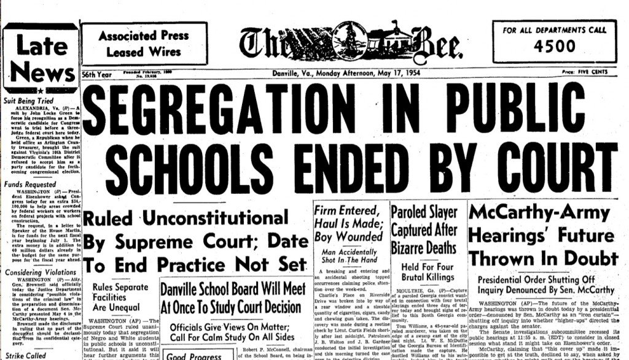

Slide 52
Certification of Compliance
The same executive order requires that federal grants and contracts include certifications from recipients that they do not operate DEI programs that violate anti-discrimination lawswhitehouse.gov.
Compliance with civil-rights laws is declared “material” to receiving federal funds– signaling that if a school is found to have, for example, a scholarship or program restricted by race, it could be deemed noncompliant and risk a False Claims Act violation or loss of funding.

Slide 53
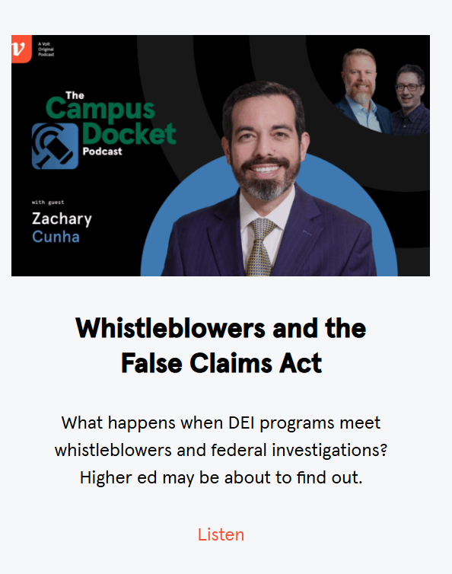

Slide 54
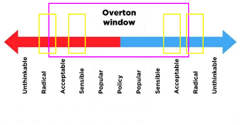

Slide 55
Legal and Policy Whiplash
Rapid swings in federal enforcement priorities—from expansive equity-focused mandates under Biden to targeted rollbacks under Trump—signal that civil rights in education will remain a deeply polarized, unstable policy arena.
Institutions must now pivot with each administration, creating compliance fatigue, legal uncertainty, and risk of inadvertent violations as definitions of discrimination shift.

Slide 56
Fragmented Legal Landscape
As courts issue conflicting rulings on what Title VI and Title IX require (e.g., transgender inclusion, race-conscious aid, DEI programming), schools and colleges face a patchwork of legal obligations.
Example: A DEI practice legal in California may be banned in Texas.
Title IX now means different things in different circuits—particularly regarding LGBTQ+ protections.

Slide 57
Conditional Federal Funding as Enforcement Weapon
The Trump administration’s use of funding freezes and certification requirements to enforce ideological alignment signals a new era of coercive compliance.
Institutions must now weigh mission integrity vs. financial survival, especially when DEI, LGBTQ+, or anti-racist practices are core to campus culture.
Future administrations—of either party—may expand this precedent, using Title VI and Title IX as blunt fiscal tools.

Slide 58
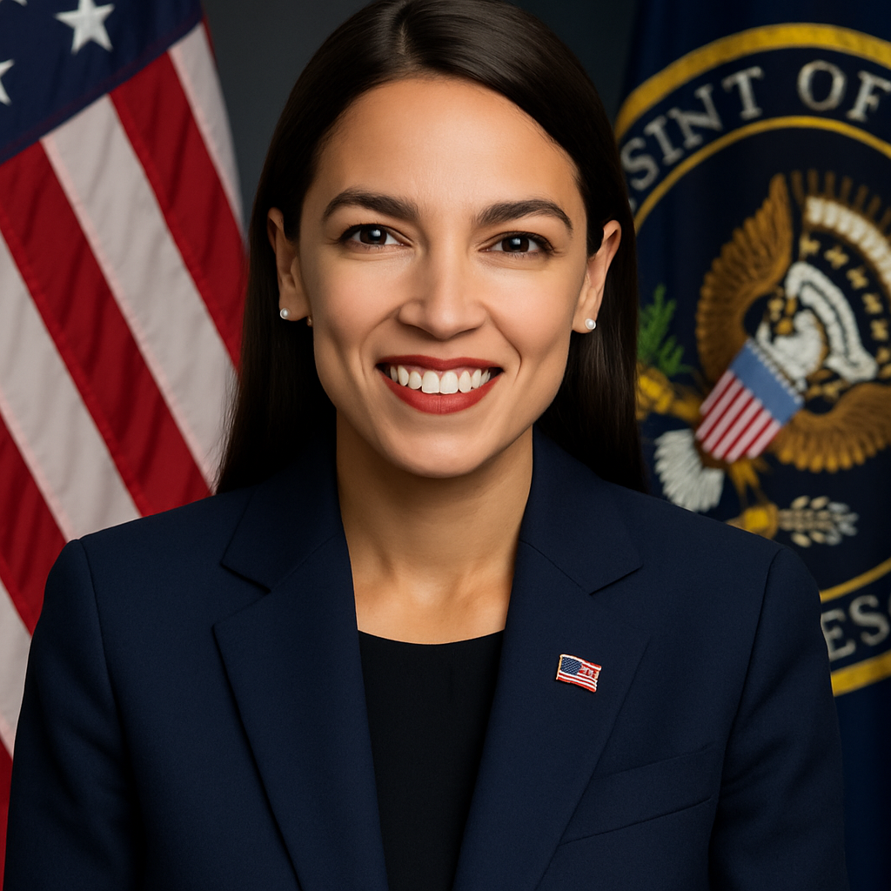

Slide 59


